Slide 1
2026 RW Request for Proposals
Bidders Webinar (1/5/2026)
Notes:
Freddie

Slide 2
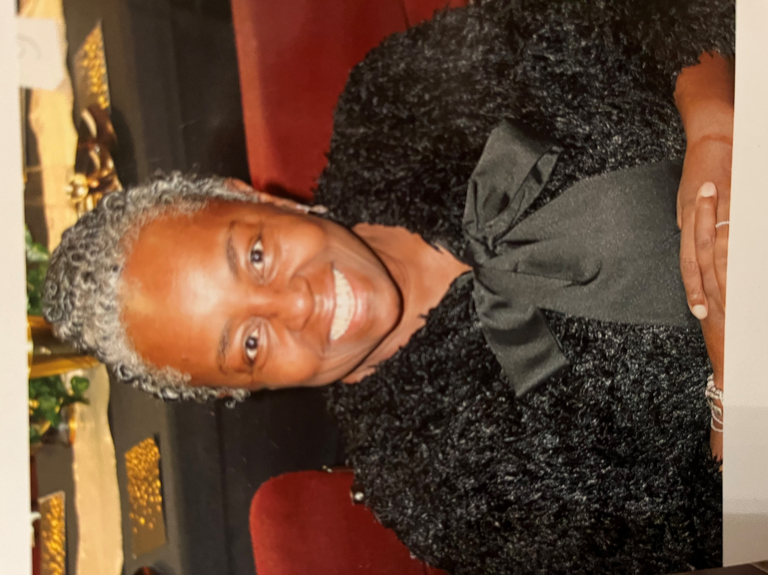
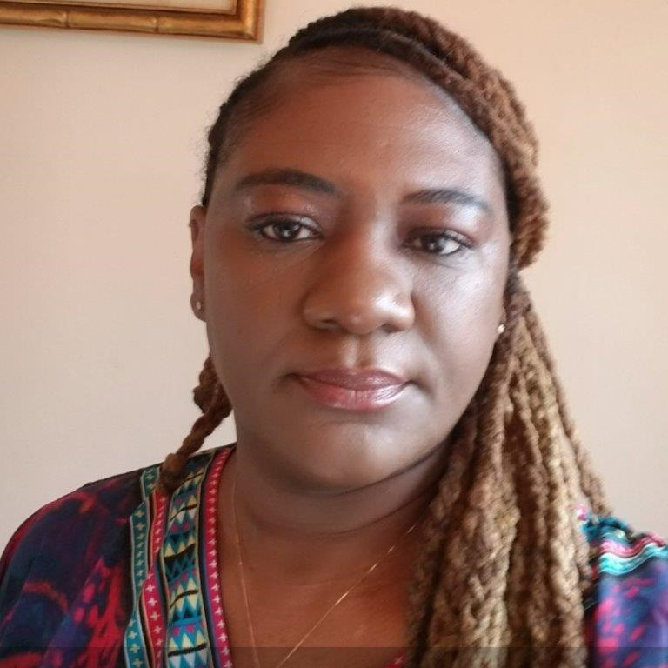
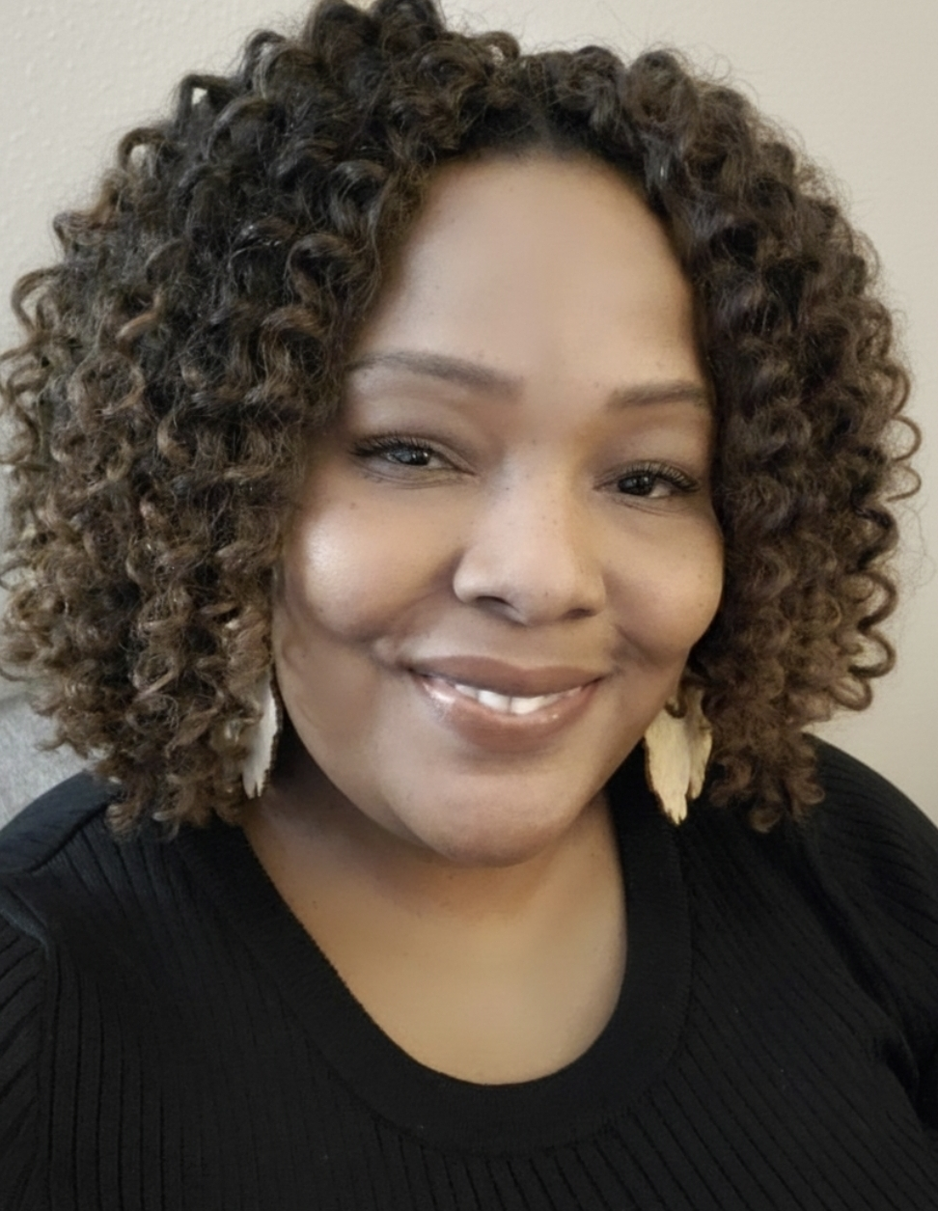
Presenters
Freddie Shufford- Vice President, Care
Lakethia Patterson - Director of RW Services
Angela Jordan – Senior Manager, Intake and Referral
Notes:
All

Slide 3
House keeping
All questions will be responded to at the conclusion of the presentation
AFC cannot respond to questions regarding how to respond to sections of the RFP
Questions not addressed fully during todays webinar can be directed to Freddie Shufford fshufford@aidschicago.org
All responses will be posted on the AFC RFP Site on a weekly basis
https://www.aidschicago.org/rw2026/
Todays webinar will be posted and can be accessed via the below link
https://www.aidschicago.org/rw2026/
Notes:
Freddie

Slide 4
About AFC
The AIDS Foundation Chicago (AFC) was established in 1985 to coordinate the local response to the AIDS epidemic in the Chicago area.
Vision
People living with HIV or chronic conditions will thrive, and there will be no new HIV cases.
Mission
AFC mobilizes communities to create equity and justice for people living with and vulnerable to HIV or chronic conditions.
Values
People First. Compassion. Accountability. Meaningful Engagement. Justice in Action. Innovation
Notes:
Freddie

Slide 5
Program overview
The Health Resources and Services Administration’s (HRSA) Ryan White HIV/AIDS Program provides a comprehensive system of HIV medical care, essential support services, and medications for low-income people living with HIV who are uninsured and underserved. The Program funds grants to states, cities/counties, and local community-based organizations to provide care and treatment services to people living with HIV to improve health outcomes and reduce HIV transmission among hard-to-reach populations.
AFC administers the Ryan White program through partner agencies with limited services on site.
Notes:
Lakethia

Slide 6
Continued
HRSA’s Ryan White HIV/AIDS Program is divided into five Parts(A,B,C,D,F). Only 2 are included in this RFP:
Part A funds medical and support services to Eligible Metropolitan Areas (EMAs) and Transitional Grant Areas (TGAs). EMAs and TGAs are counties/cities that are the most severely affected by the HIV/AIDS epidemic. The grantee is the Chicago Department of Public Health.
Part B administers funds for states and territories to improve the quality, availability, and organization of HIV health care and support services. Part B also includes grants for the AIDS Drug Assistance Program (ADAP). The grantee is the Illinois Department of Public Health.
Notes:
Lakethia

Slide 7
Funding Priorities
Getting to Zero Illinois (GTZ-IL) initiative: The GTZ-IL plan outlines strategies to increase access to and uptake of PrEP (pre-exposure prophylaxis) and increasing the number of people living with HIV who are virally suppressed (https://gtzillinois.hiv)
The treatment cascade: A continuous care paradigm that outlines the stages of HIV medical care from initial diagnosis to achieving viral suppression while tracking individuals at each stage.
National HIV AIDS Strategy: The Strategy sets bold targets for ending the HIV epidemic in the United States by 2030, including a 75% reduction in new HIV infections by 2025 and a 90% reduction by 2030.
Agencies that provide culturally responsive services: Programs with documented culturally trained staff, programs that improve access and remove barriers with the goal of reducing inequities for the target population.
Agencies that are filling gaps in services areas: Programs that have multiple locations, or collaborations that expands their services area to communities that are underserved and/or under resourced.
Notes:
Freddie

Slide 8
Available Funding
Category | Part A or B | Category | Anticipated Number of Awards | Total Anticipated Funding
Ambulatory Outpatient Medical Care | Part B | Core | 5–7 | $250,000–$350,000
Medical Case Management (perinatal, corrections, medical benefits staff) | Part A / B | Core | 10–20 | $7M–$7.2M
Medical Nutrition Therapy | Part B | Core | 1–2 | $10,000–$20,000
Mental Health | Part B | Core | 6-8 | $70,000–$90,000
Oral Health Care | Part B | Core | 4–6 | $100,000–$200,000
Substance Abuse Outpatient | Part B | Core | 4-6 | $20,000–$30,000
Food Bank/Home Delivered Meals | Part B | Supportive | 4-6 | $150,000–$200,000
Housing | Part B | Supportive | 4–6 | $60,000–$80,000
Legal Assistance | Part B | Supportive | 1–2 | $40,000–$60,000
Non-Medical Case Management (Peer, Retention specialist) | Part B | Supportive | 10-15 | $600,000–$800,000
Psychosocial | Part B | Supportive | 4-6 | $30,000–$50,000
8
Notes:
Angela
Approximately $8.8 million will be distributed through this funding opportunity. Service category definitions are documented in the Funded Service Category Requirements section (Appendix A). Funding levels will be based on identified need and service gaps, as well as current service utilization and projected gaps in services.

Slide 9
Key Dates
Activity | Key Dates & Times
Intent to Apply | January 9, 2026, by 4:00 p.m.
Proposal Submission Date | January 26, 2026, by 12:00 p.m.
Award Notification Date | February 9, 2026
Contract Start Date | March 1, 2026 (Part A) or April 1, 2026 (Part B)
9
Notes:
Angela
AFC anticipates announcing contract awards on December 1, 2022. Funding cycles for successful Ryan White Part A applicants will begin March 1, 2023, and for successfully awarded Part B applicants on April 1, 2023. Awards will be for a minimum of three years unless an agency fails to meet service delivery requirements.

Slide 10
Eligible Respondents
Operate a physical site and/or deliver services (with no physical site) in the Chicago Eligible Metropolitan Area, including Cook County, DeKalb and the seven collar counties: DuPage, Grundy, Kane, Kendall, Lake, McHenry and Will.
Be governed by a board of directors.
Be a community-based organization, community health center, hospital, health department, mental health center, substance abuse treatment center, university, nonprofit organization, or private for-profit organization*.
Have a functioning accounting system that is operated in accordance with generally accepted accounting principles or an agreement with a designated eligible entity that maintains such information and acts as the respondent’s fiscal agent.
Be Medicaid-certified if providing services that are Medicaid-eligible.
Have all required licenses and certifications required by appropriate government agencies to perform the proposed services and procure all permits and pay all charges, taxes, and fees.
10
Notes:
Angela
* Private for-profit entities may apply for these funds if they can adequately demonstrate that they are the only provider of quality HIV services for a specific category in the geographic area they intend to serve.

Slide 11
Client Eligibility
Documentation of client eligibility must occur immediately upon client consent to enroll in a Ryan White program or service.
Eligibility documentation consists of proof of
HIV-positive serostatus (e.g., detectable lab results or physician statement),
Proof of residence in the Chicago EMA
Proof of income (800% of the Federal Poverty Level (FPL) or less for case management, 80% of the Area Median Income for housing, and 500% FPL or less for all other services).
11
Notes:
Lakethia
The primary intent of Ryan White CARE Act funding is the provision of care, treatment service, and support services to achieve improved medical outcomes for individuals living with HIV/AIDS. All contracted providers receiving Ryan White funding must have systems in place that document and ensure client eligibility.

Slide 12
Tiered Case Management System
Clients with exceedingly high levels of need
Example: Supportive Housing, Perinatal, Corrections, DRS
Focuses on facilitating active links to primary medical care and other core services with an added emphasis on treatment and appointment adherence
Focuses on providing self sufficient clients with additional RW supportive resources
Intensive
Medical
Non-
Medical
Notes:
Lakethia

Slide 13
case management tiers
Correction – incarcerated within the last 6 months or scheduled for release in 120 days
Perinatal- currently pregnant or has been in the last 6 months or in active family planning stage
Medical Case Management – Newly diagnosed, high need, high viral load
Non-Medical Case Management –( Retention Specialist; Peer Navigator;) Stable, low need and undetectable viral load
Intake and referral team receive client calls through the Care Plus and the Resource HUB Hotline and these clients are referred to agencies as needed based on the type of case management and geography and client preference
Notes:
Lakethia

Slide 14
Client Eligibility
Case management is the gatekeepers to all services. This means that services are billable only if documents created by a case manager (Eligibility assessment and care plan) are in place. Services to clients who have not completed a case management assessment and care plan are not eligible for reimbursement by AFC.
All RW service categories except case management are considered fee for service and can be considered billable with an eligibility assessment and care plan in place.(note: care plan is not required if enrolled in non-medical case management)
Example: If a client receives care from a dentist without an eligibility assessment and care plan documented in Provide, the reimbursement request will be rejected.
12
Notes:
Lakethia

Slide 15
Program Requirements
All agencies must utilize Provide Enterprise software system to capture all data
Case managers must document all service activity daily or within 5 business days
Case Managers must participate in at least 12 training in a program year
Case management agencies ONLY must submit quarterly narrative reports regarding, utilization, trends, successes and barriers
Non case management/Fee for service agencies must submit all client level billing in the Provide database monthly
Ryan White is the payer of last resort.
A representative must attend bi-monthly Contract
Administrators' meetings…(Case management agencies) ONLY
13
Notes:
Lakethia

Slide 16
How to Apply
Submit Intent to Apply to AFC by January 9, 2026
  Select the service categories you intend to provide
  Indicate the program contact
  https://forms.office.com/r/diNsMEx0eS
Once intent is received, AFC will make available the agency’s proposal submission folder via email from SharePoint to the program contact
Proposal must be uploaded by the deadline (January 26, 2026)
14
Notes:
Freddie

Slide 17
Proposal Organization
Follow formatting guidelines
  Table of Contents
  Section numbering
Appendix numbering – If you do not have or need to submit one or more of the sections or appendices listed, include a blank page for that appendix labeling it “Section/Appendix # Title not applicable”.
Spell / grammar check
Narrative should be clear & concise. Avoid fluff & jargon. Spell out acronyms.
15
Notes:
Freddie
Read formatting instructions carefully
DO NOT REFORMAT
Stay in page limits
Goal: write clearly, concisely. Avoid fluff and unnecessary jargon. Efficient writing.

Slide 18

Proposal Submission
Notes:
Freddie

Slide 19
RFP Narrative
The listing below is for all the narrative sections to be completed. Please note that if your agency applies for multiple service categories, some narrative sections will be required to be completed for each service category you apply for.
Agency Experience
Target Population Needs
Cultural & Linguistic Capacity & Health Equity
Organizational and Fiscal Capacity
Payer of Last Resort
Quality Management
Core and Supportive Services (excluding case management) (if applicable) If applying for multiple applicable service categories, complete this section separately for each service category.
Case Management (Medical and Non-Medical) (if applicable) If applying for Case Management, complete this section separately for medical and non-medical.
17
Notes:
Freddie
Note that underlined service categories need to be submitted multiple times

Slide 20
RFP Narrative
Provide narrative addressing the following:
1) Describe the agency’s overall mission and service portfolio (no points)
Your agency’s response here
2) Describe the geographic area in which services are provided and where sites are located (no points)
Your agency’s response here
3) Describe the agency’s experience providing care services to persons living with HIV/AIDS. If a current provider in AFC’s Case Management collaborative, outline results from your organization’s most recent programmatic and fiscal site visits. What are areas of strength and areas for improvement?
Your agency’s response here
4)Describe how your agency defines and assures equity within your programs. (Be specific about access, removing barriers and closing equity gaps).
Your agency’s response here
Section 2. Agency Experience (3 pgs. maximum) | Maximum Points: 10
Example of Narrative Submission
Agency ACME intends to apply for Mental Health, Oral health and Medical Case Management
Complete sections 1-7
Complete section 8 twice, once for mental health and once for oral health
Complete section 9 once for medical case management
18
Notes:
Freddie
Please note that each section must be started on a new page

Slide 21
RFP Appendices
List of Appendices: Please note that if your agency applies for multiple service categories, some appendices will be required to be completed for each service category you apply for.
Appendix 1 | Internal Revenue Service 501(c)3
Appendix 2 | Proof of Valid registration in the system for award management, SAM.GOV
Appendix 3 | Client Demographics Template
Appendix 4 | Resumes & Job Descriptions for Key Staff; Relevant staff (new applicants only) and agency certifications and licenses (all applicants)
Appendix 5 | *Medicaid Certification (if applicable)
Appendix 6 | Budget (case management services only) If applying for both Medical Case Management and Non-Medical Case Management, complete this form twice.
Appendix 7 | Most recent financial statement or independent audit, OMB Circular A-133 Audit
Agency ACME intends to apply for Mental Health, Oral health and Medical Case Management
  Attach appendices 1-3, 5, 7 once
  Attach appendices 4 three times, once for mental health, once for oral health and once for medical case management
  Attach appendices 6 once for case management
20
Notes:
Freddie
Categories that are Medicaid Billable such as Ambulatory, Mental Health, Substance Use, Oral Health
Please note that: Appendices underlined must be submitted several times

Slide 22
Accessing RFP Workbooks
https://www.aidschicago.org/rw2026/
Agencies will download
  Ryan White RFP (pdf)
  RFP Narrative Workbook (MS Word)
  RFP Forms Workbook (MS Word)
22
Notes:
Freddie

Slide 23
SharePoint
Submit your documents using the SharePoint access link that will be provided upon submission of your organization’s Intent to Apply form.
How to Upload Files to SharePoint
For step-by-step guide to upload files to SharePoint, go to: https://support.office.com/en-us/article/Instructions Upload-files-to-a-library
AFC encourages agencies to read the file upload instructions to access the upload link well before the proposal due date to ensure there are no technical challenges. Email fshufford@aidschicago.org with technical questions.
23
Notes:
Freddie
How to upload the files to submit them

Slide 24
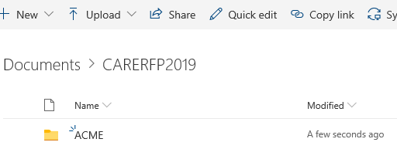
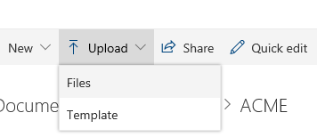
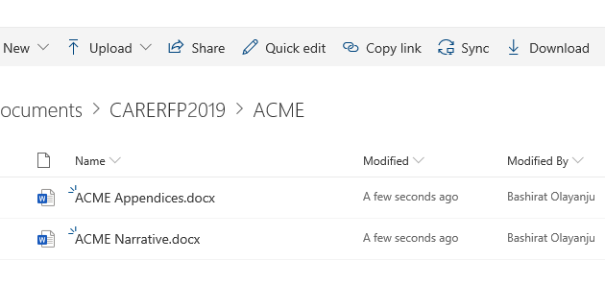
Sample submission through
SharePoint
2
1
3
24
Notes:
Freddie

Slide 25
Formatting
Ensure that the two separate PDF files are uploaded using the naming convention below.
File #1: Agency Name Narrative.pdf
File #2: Agency Name Appendices.pdf
For example, agency “ACME” submits a proposal for three service categories. The agency will upload two documents to SharePoint. File names would be:
“ACME Narrative.pdf” and “ACME Appendices.pdf”
25
Notes:
Freddie
Ensuring consistency in naming the files
Each file will include any and all responses for your applications including multiple narratives and appendices if you are applying for more than one service category

Slide 26
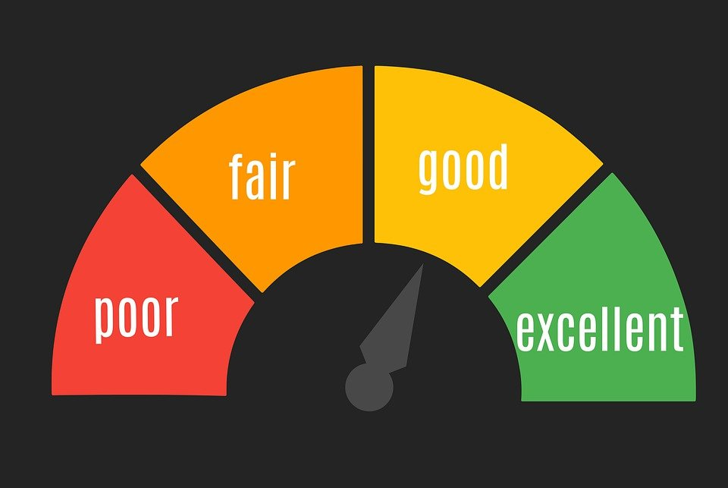
Proposal Review
Notes:
Angela

Slide 27
Proposal Review & Scoring
Consensus Scoring Process Steps:
AFC has recruited review panelists to review applications. Each application will be reviewed by 3 reviewers
Review panelists will convene to discuss each proposal
Final scores will comprise of 60% proposal, 25% health equity index, 15% past performance (new agencies automatically get 15%).
27
Notes:
Angela
AFC will compile panelist comments and scores to make final award determinations. Past performance of previously funded agencies may be considered in AFC’s final award determination. To ensure geographic distribution of services, AFC reserves the right to recommend qualified funding proposals that do not adhere to the review panel consensus scores. If an insufficient number of qualified proposals are submitted in any service category, AFC reserves the right to directly solicit and select appropriate providers to fill existing gaps in service.

Slide 28
Proposal Evaluation Dimensions
"0" Does Not Meet Requirements: Response does not meet RFP requirements and includes omissions, errors, and/or defects that are unacceptable.
"1" Somewhat Meets Requirements: Response meets some but not all RFP requirements. Questions are answered with minimal omissions or errors.
"2" Meets Requirements: Questions are answered completely, contain descriptive details, and have no omissions..
"3" Excellent: Response exceeds RFP specifications. Narrative responses clearly detail the agency’s operationalized best practices and innovative or enhanced approaches.
28
Notes:
Angela
Narrative sections will be scored based on the following four point criteria
Review panelists will evaluate applicant responses and assign each narrative section question a score between “0” and “3” based on these criteria

Slide 29
Proposal Points Allocation
The table below highlights the maximum score each section can obtain.
Narrative Sections | Possible Points
Table of Contents | 0
Agency Experience | 10
Target Population Needs | 10
Cultural & Linguistic Capacity & Health Equity | 20
Organizational and Fiscal Capacity | 20
Payer of Last Resort | 10
Quality Management | 10
* Core and Supportive Services (excluding case management) | 20
* Case Management (Medical and Non-Medical)Categories | 20
Total possible points per service category | 100
29
Notes:
Angela
*Narrative sections with an asterisk will be scored multiple times with a maximum score of 24 per service category
AFC will utilize a Consensus Review Panel Process in which all review panelists will convene to discuss their proposal review, including individual panelist scoring.
The review panel will agree on a single consensus (group) score for each section. Agencies will receive a total score for each service category for which they have applied; therefore, points assigned for narrative sections completed multiple times will only count toward scoring their respective service categories. The consensus scores will be summed by AFC.

Slide 30
Other Support Provided
Database training and support
Ticketing system for questions
Policy and quality management plan support
For brand new agencies, AFC will host monthly support sessions with each agency to ensure proper onboarding
Over 80 trainings will be available per year through AFC on multiple topics to support case managers and other staff
  Some trainings are mandatory for example cultural competence
Translation services
Medical transportation and food vouchers (through case manager ONLY)
Other resource supports
Notes:
Angela

Slide 31
Thank you!
https://www.aidschicago.org/rw2026/
INTENT TO APPLY DUE: FRIDAY, January 9, 2026
PROPOSAL DUE: FRIDAY, January 26, 2026
For questions, please contact Freddie Shufford, Vice President, Care, at fshufford@aidschicago.org or
312-334-0930.
Email Subject Header: “2026 Ryan White RFP Questions”
30
Notes:
Freddie

Slide 32

Questions
Notes:
Freddie

